Slide 1

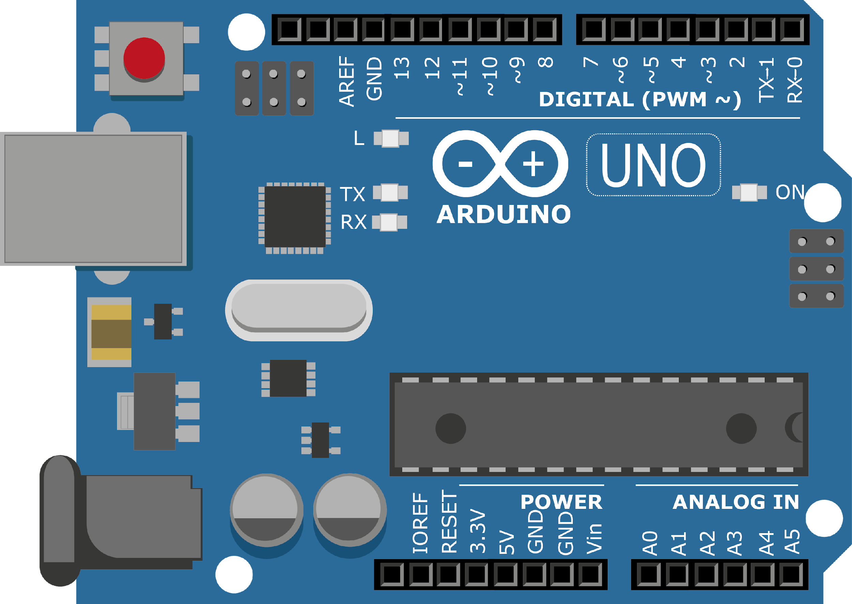
ARDUINO MASTER CLASS
28
Industry Monitoring System | IoT

Slide 2
28 AGENDA
02
03
01
Industry Monitoring System
Internet of Things
Interview questions & News

Slide 3

Internet of Things
The Internet of things describes the network of physical objects—“things”—that are embedded with sensors, software, and other technologies for the purpose of connecting and exchanging data with other devices and systems over the Internet.

Slide 4
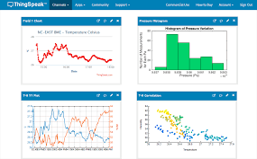
Thingspeak
ThingSpeak is an open-source Internet of Things application and API to store and retrieve data from things using the HTTP and MQTT protocol over the Internet or via a Local Area Network
ThingSpeak is an IoT analytics platform service that allows you to aggregate, visualize, and analyze live data streams in the cloud. You can send data to ThingSpeak from your devices, create instant visualization of live data, and send alerts.

Slide 5
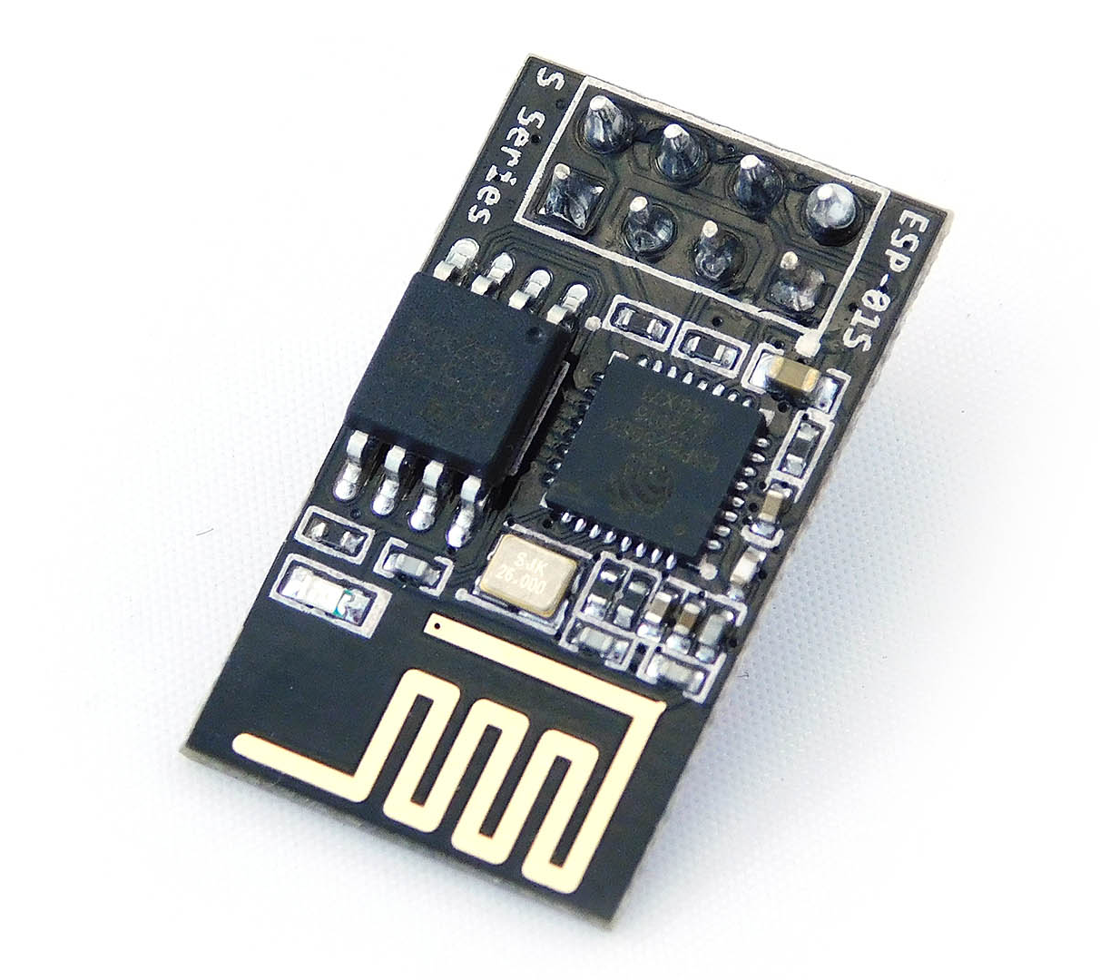
ESP8266
32-bit RISC CPU: Tensilica Xtensa LX106 running at 80 MHz **
64 KiB of instruction RAM, 96 KiB of data RAM
External QSPI flash – 512 KiB to 4 MiB* (up to 16 MiB is supported)
IEEE 802.11 b/g/n Wi-Fi
Integrated TR switch, balun, LNA, power amplifier and matching network
WEP or WPA/WPA2 authentication, or open networks
16 GPIO pins **
SPI, I²C,
I²S interfaces with DMA (sharing pins with GPIO)
UART on dedicated pins, plus a transmit-only UART can be enabled on GPIO2
1 10-bit ADC

Slide 6
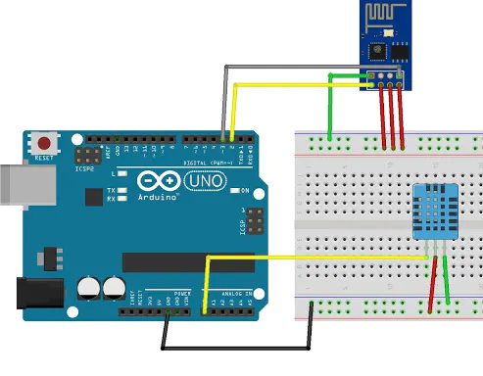
ESP8266 with Arduino

Slide 7

INTERVIEW QUESTIONS
Flags in 8086
Why crystal is preferred for clock source?
pipelining in microprocessor
carry flag, parity flag, auxiliary carry flag, zero flags, an overflow flag, trace flag, interrupt flag, direction flag, and sign flag
Pipelining is an implementation technique where multiple instructions are overlapped in execution. Pipelining does not decrease the time for individual instruction execution
The main reason to use crystal is high stability and accurate frequency which remains constant all the time.

Slide 8
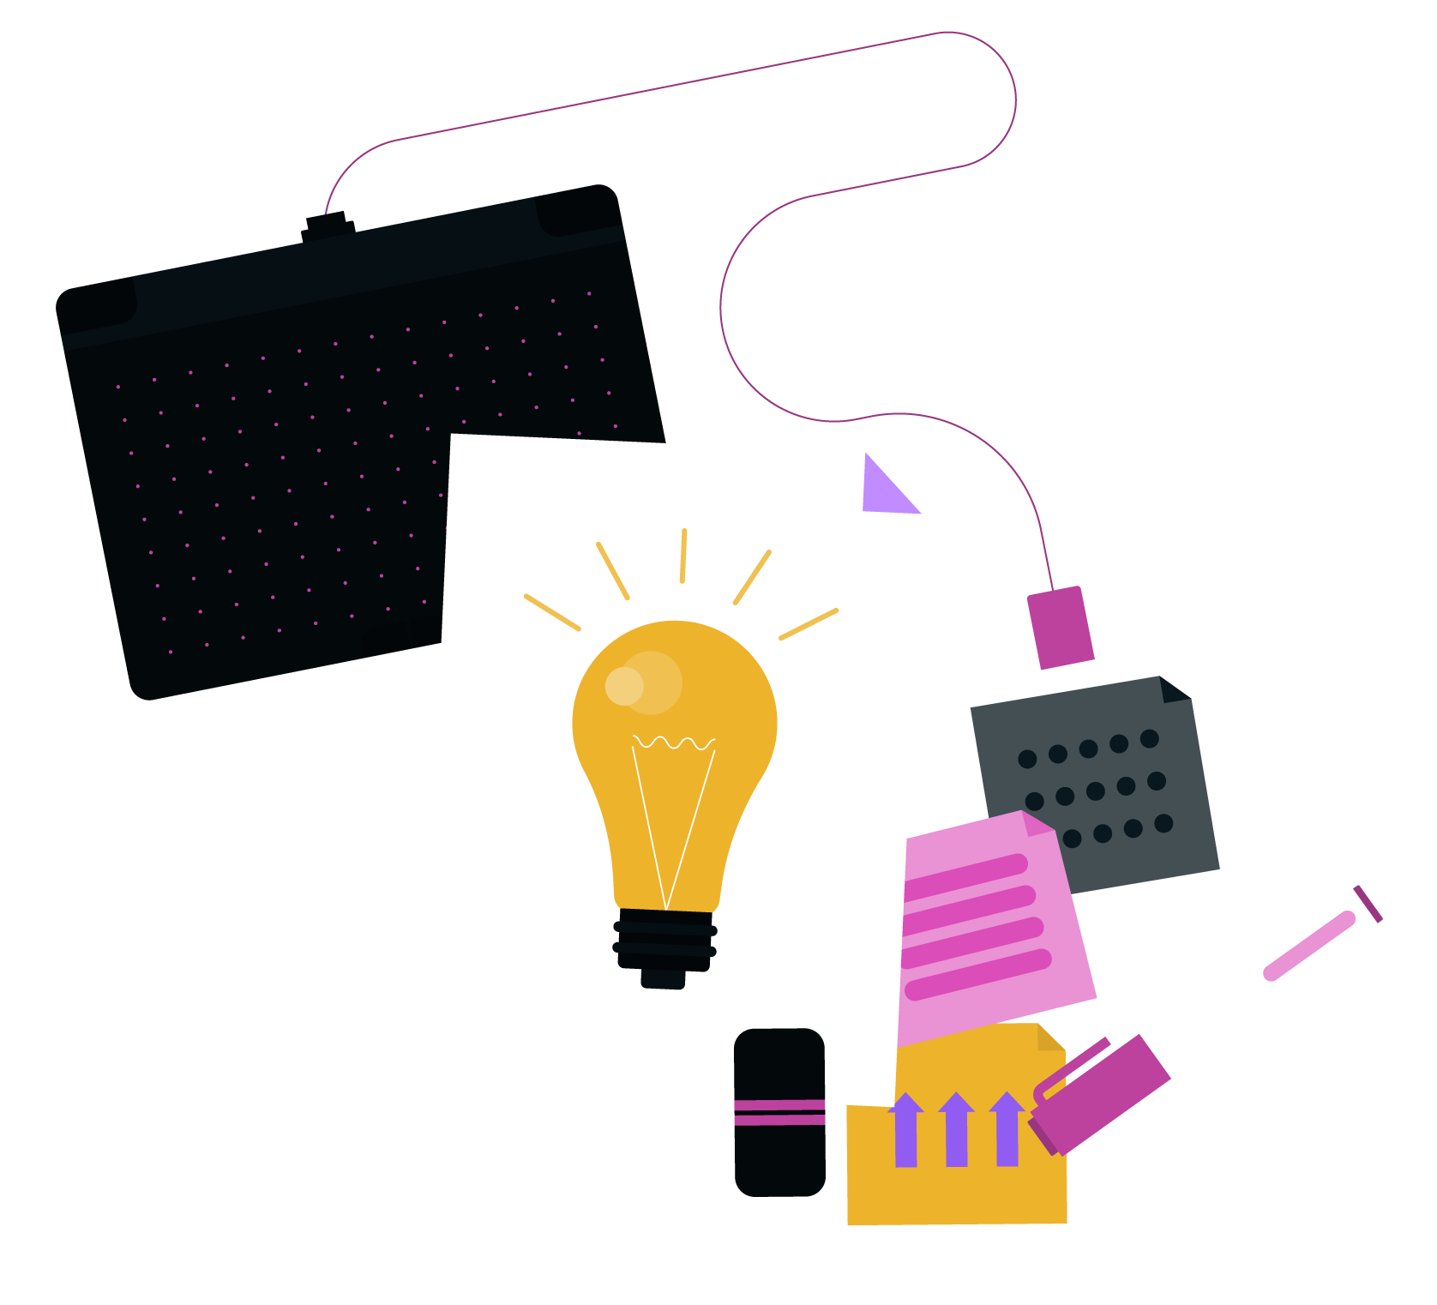
THANKS!

